Slide 1
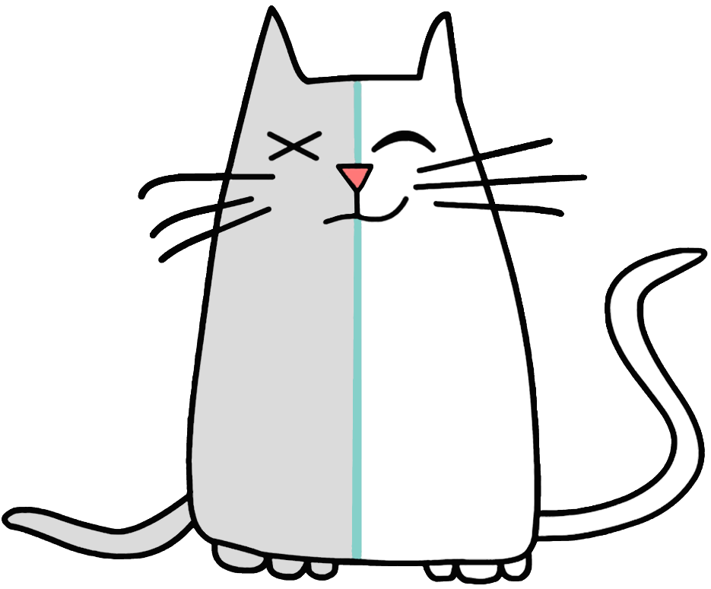
HyperDbg
ACM Conference on Computer and Communications Security (CCS)
November 2022

Slide 2







Slide 3

It’s a
Transparent
High-Performance
Hypervisor-Assisted
Debugger
Notes:
What is it?

Slide 4


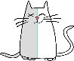



 | User Mode Debuggers | Kernel Mode Debuggers | Other sub-kernel debugging solutions | HyperDbg
Privilege | Ring > 0 | Ring 0 | Ring < 0 | Ring -1
Transparency | Low | Medium | High | High
Performance | Medium | Medium | Low | High
Practicality | High | High | Low | High
x64dbg
WinDbg
Malt
HyperDbg
OllyDbg
GDB
Ether
Immunity Debugger

Slide 5
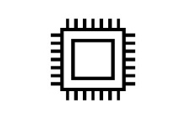

Back End
Front End
Guest
Host
Debugee
HW
HyperDbg
(Dis)assemble
Kernel mode
VMX-Root Mode
Script Engine
xor rdi, rdi xor rsi, rsi xor rdx, rdx sysret
Interpreter
Parser
Scanner
I/O Dbg.
Emulator sub-sys.
IDT Monitor
IR code Gen.
User mode
Event-Triggered Interface
Comm. Interface
mov rax, 0x15
mov rbx, 0x756985
push rbx
mov rdi, rsp
mov al, 0x55
syscall
VMX Mem. Mgt.
Hooking sub-sys.
Stepping sub-sys.
CLI
Commands
Event: An incident of interest
Syscall, specific memory access, …
Condition: Logical expressions constraining event triggers
Action: A set of functionalities following an event
Break, script (view/modify memory, registers), log,…
Script Engine on backend
C-like: if, else, for, printf
Notes:
First script engine on hypervisor VMX-root mode, no API OS

Slide 6
Back End
Front End
Guest
Host
Debugee
HW
HyperDbg
(Dis)assemble
Kernel mode
VMX-Root Mode
Script Engine
xor rdi, rdi xor rsi, rsi xor rdx, rdx sysret
Interpreter
Parser
Scanner
I/O Dbg.
Emulator sub-sys.
IDT Monitor
IR code Gen.
User mode
Event-Triggered Interface
Comm. Interface
mov rax, 0x15
mov rbx, 0x756985
push rbx
mov rdi, rsp
mov al, 0x55
syscall
VMX Mem. Mgt.
Hooking sub-sys.
Stepping sub-sys.
CLI
Commands
Performance
CPU Features (e.g., VT-x, EPT)
Script Engine
Efficient low-level implementation
Privilege
VMX-Root Mode
Transparency
Stealth in design

Slide 7


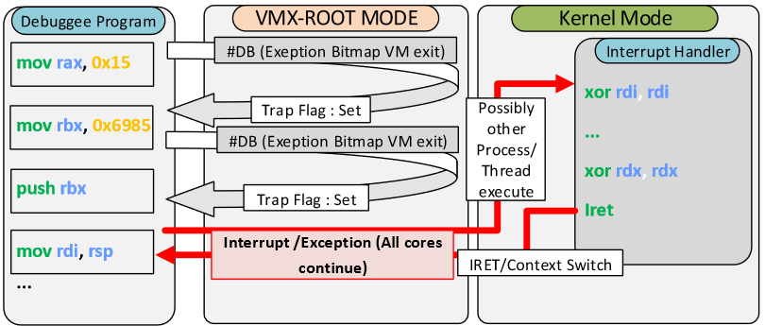
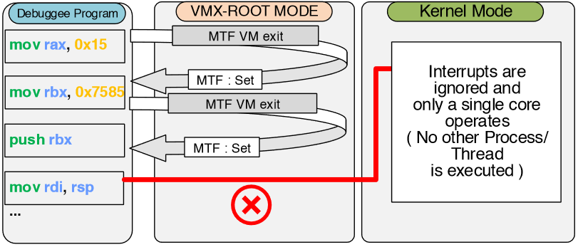
Stepping Subsystem
Guaranteed line by line instrumentation
VMX-Enable Single Core execution /Interrupt Masking
MTF+VM exit (and NMI/PIN Based VM EX Control)

Slide 8
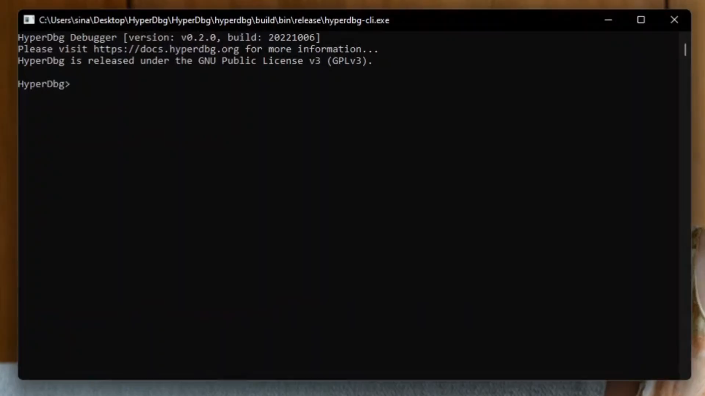

Slide 9
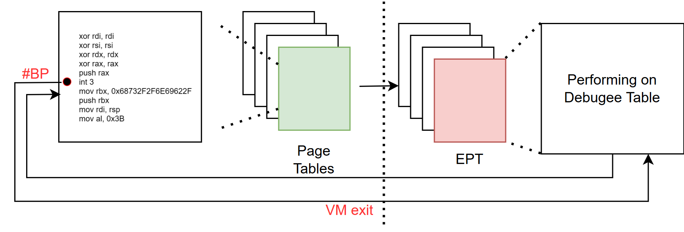
Hooking Subsystem
Transparent Hooking
EPT-Hook and Debug Register Emulation

Slide 10
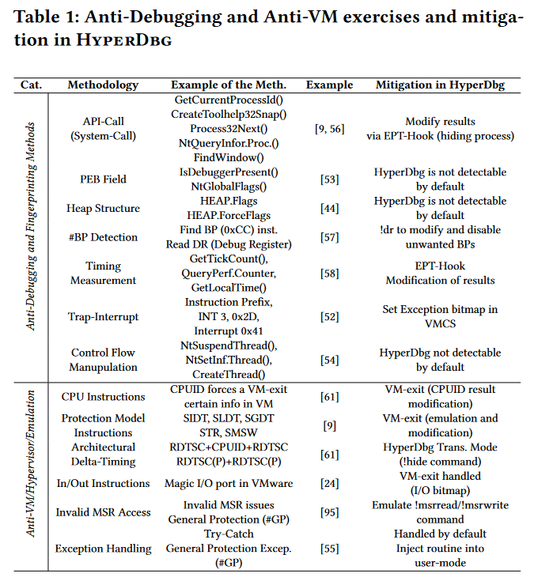
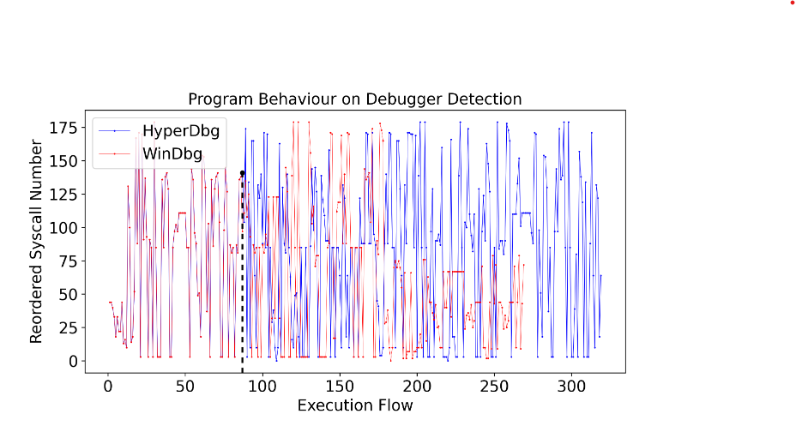
Transparency

Slide 11
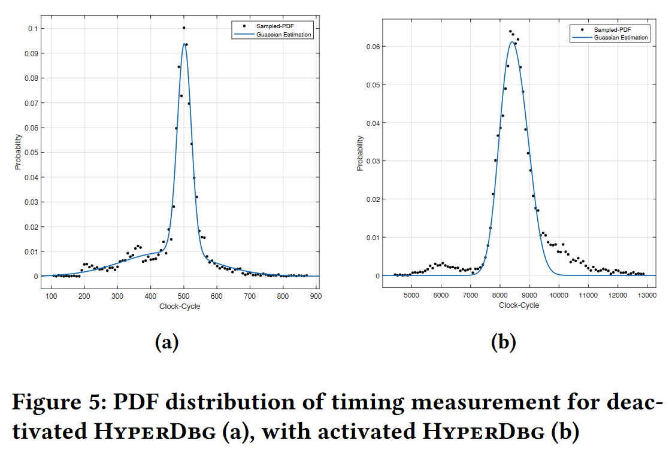
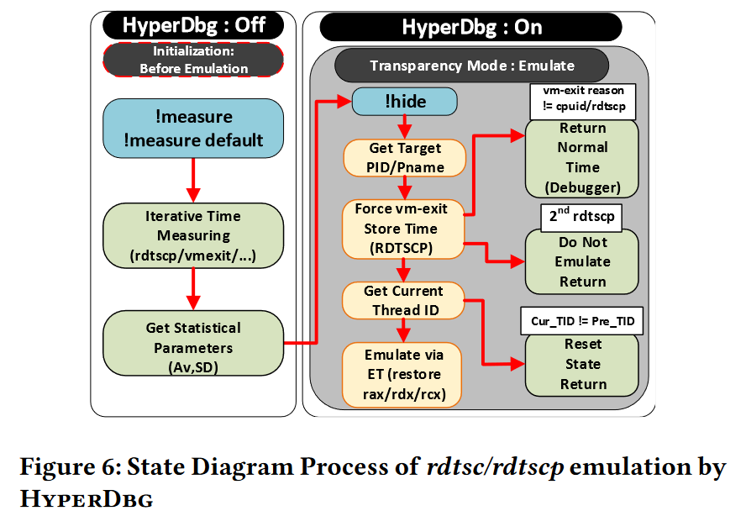
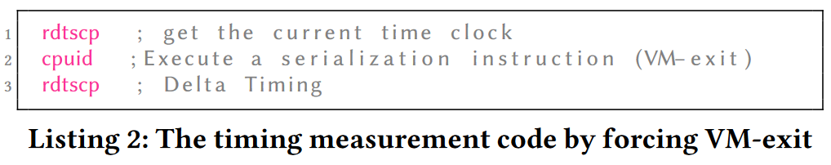
Timing Transparency

Slide 12
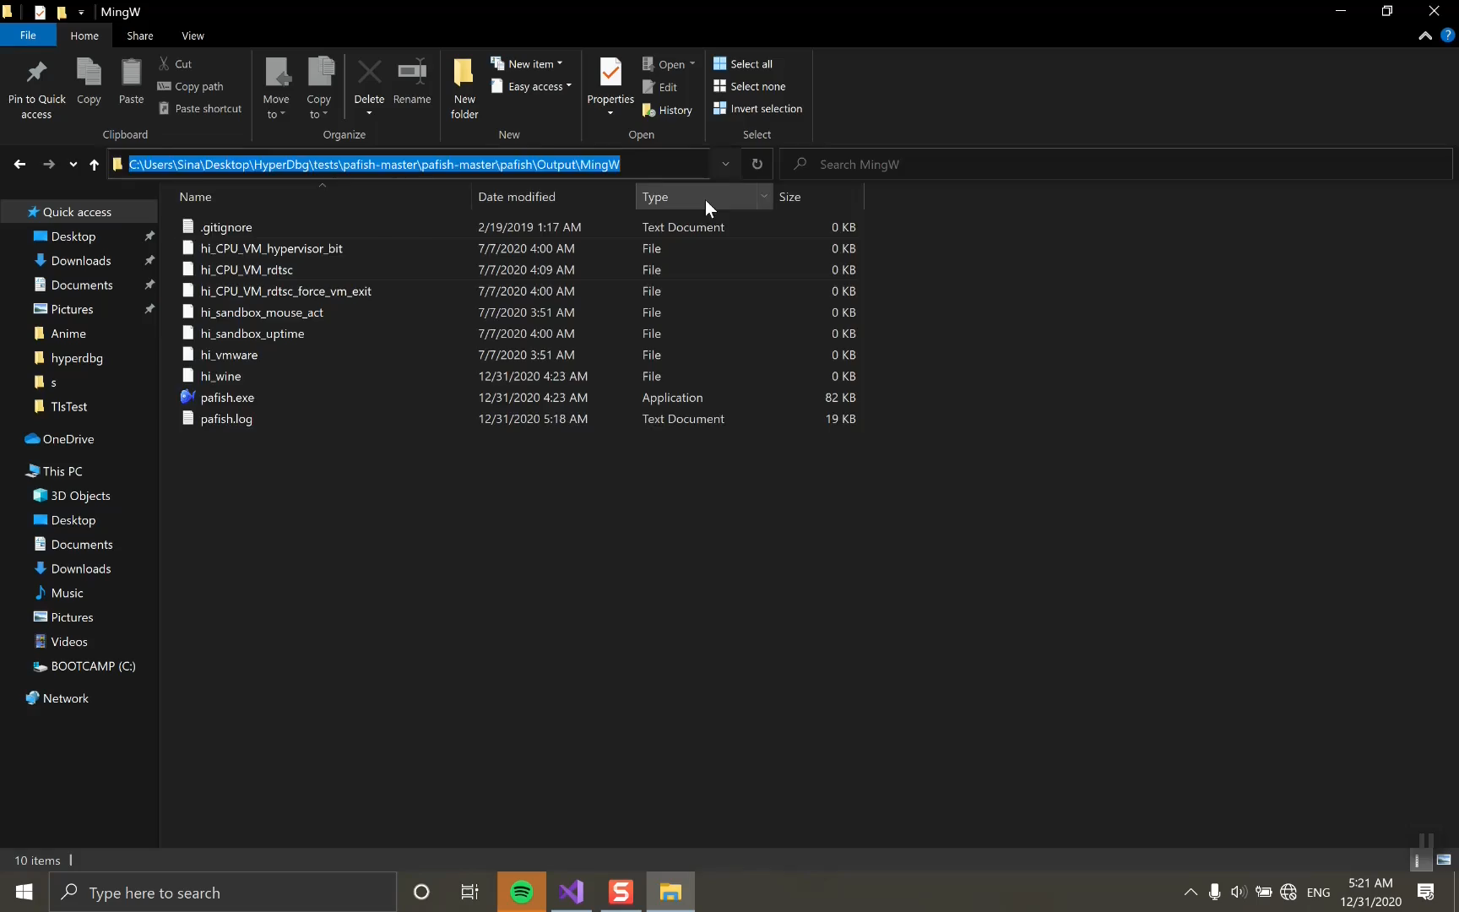

Slide 13
Performance
x2.97
HyperDbg
x2.97
WinDbg
HyperDbg
x1319
WinDbg
HyperDbg
x2018
WinDbg

Slide 14
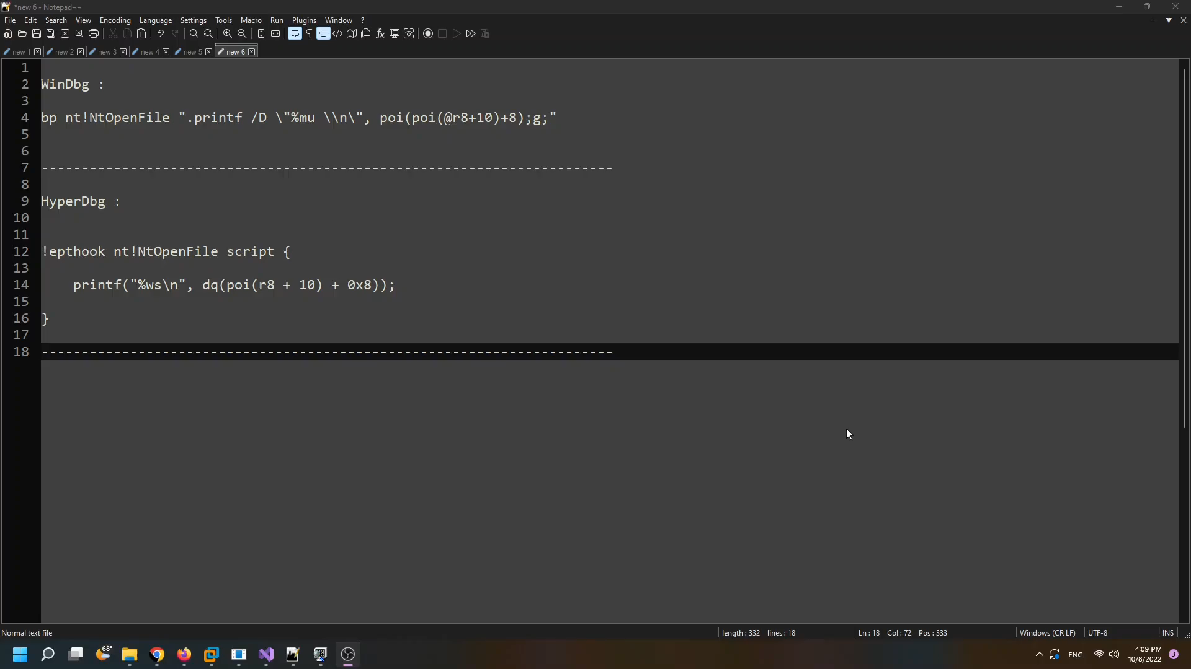

Slide 15




Evasive Malware Analysis
x
(
Kernel Fuzzing
x
I/O Debugging
Notes:
But why would we need all that?

Slide 16
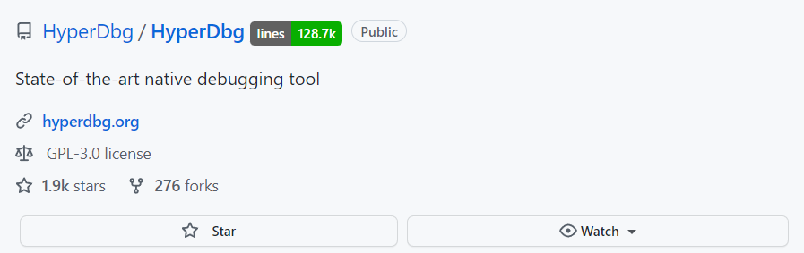
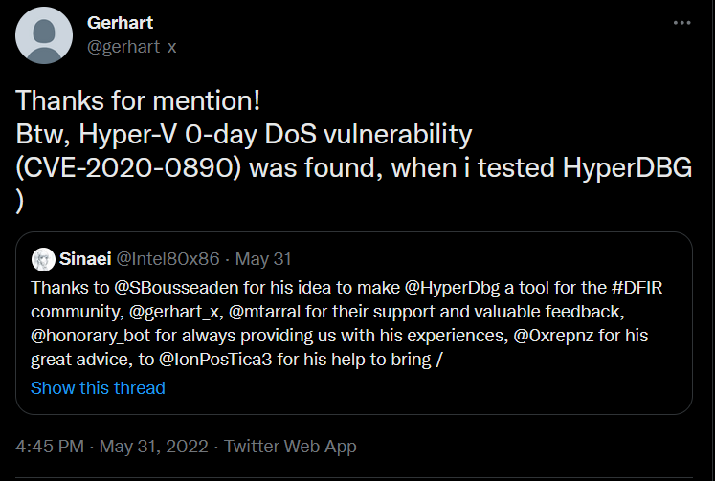
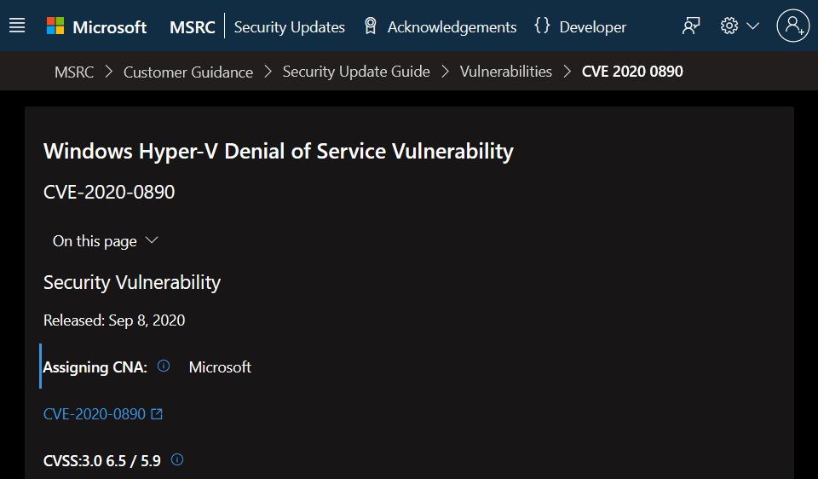
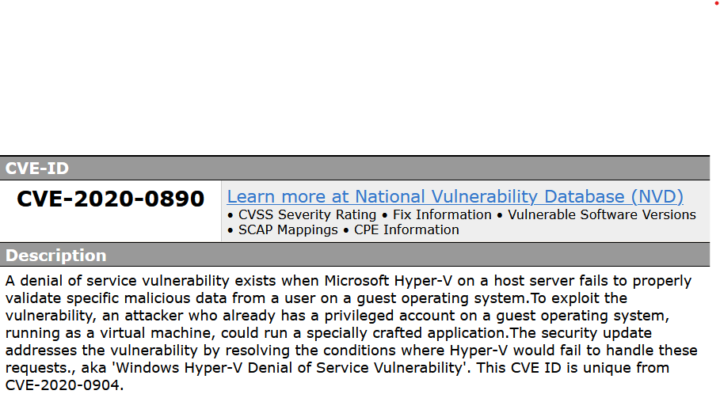
HyperDbg in the Wild
Over 125k+ lines of code
Over 2.5 years of development

Slide 17
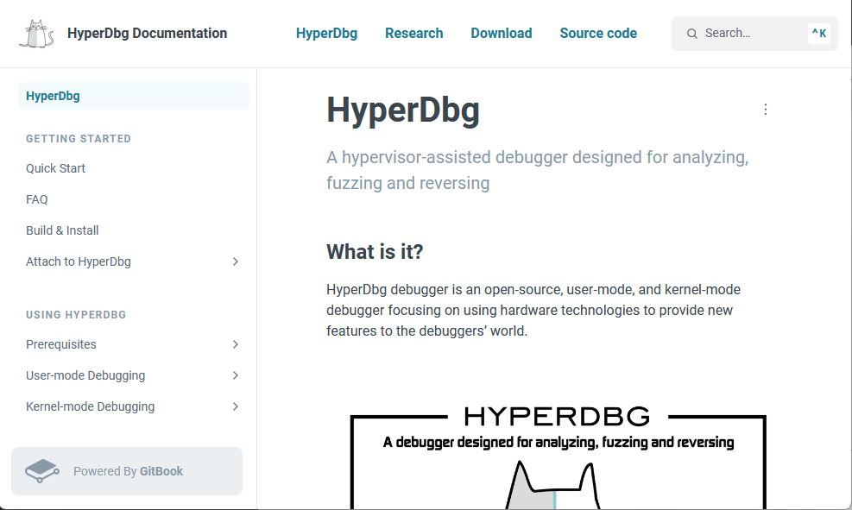
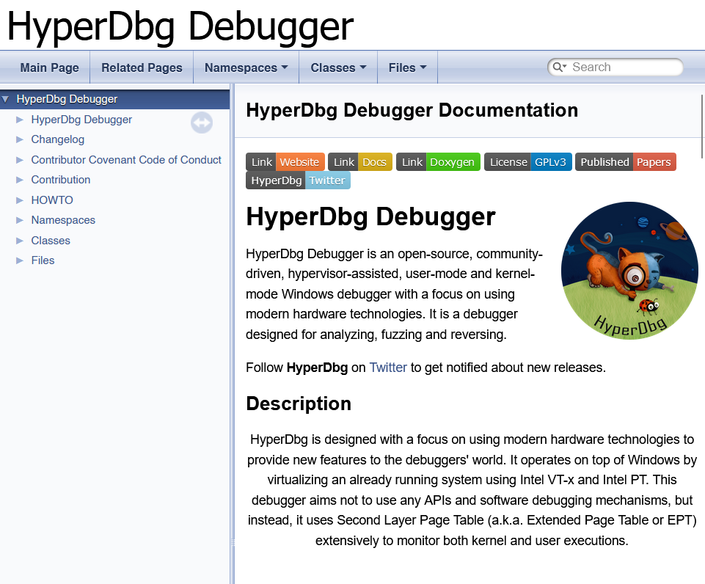
https://docs.hyperdbg.org/
https://doxygen.hyperdbg.org/

Slide 18
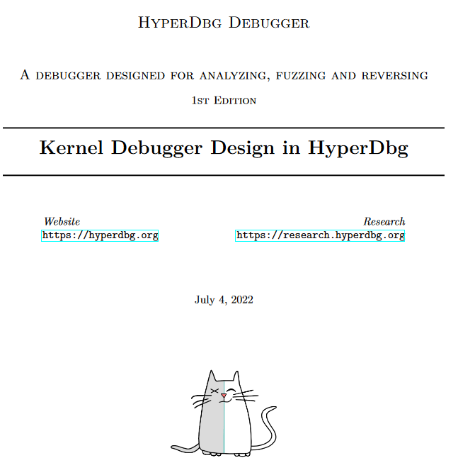
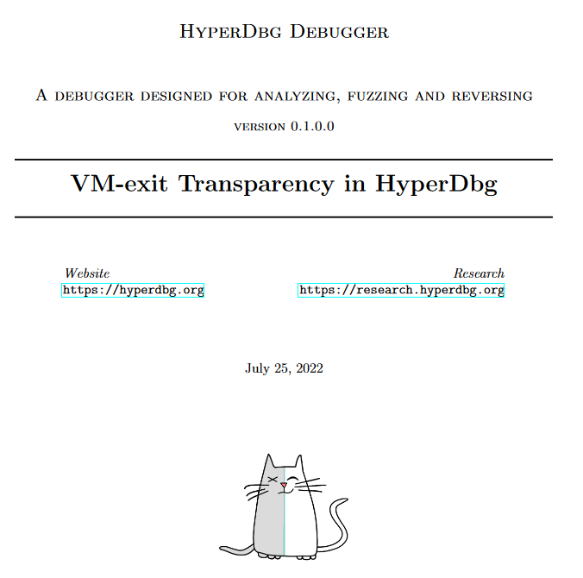
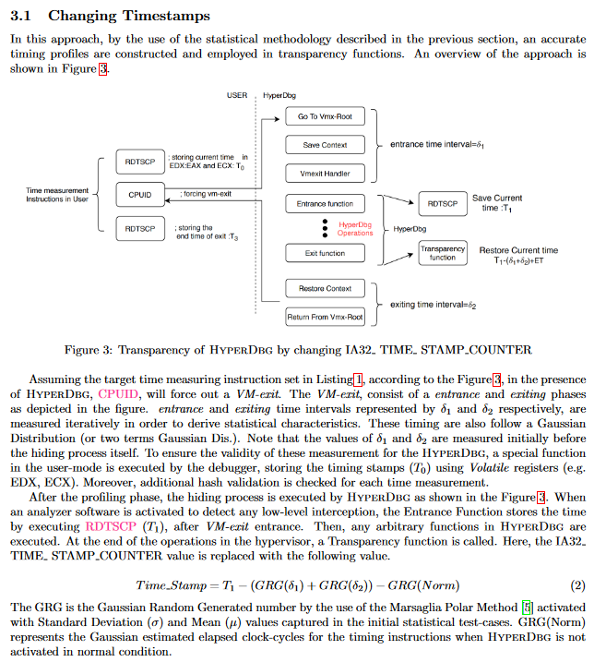
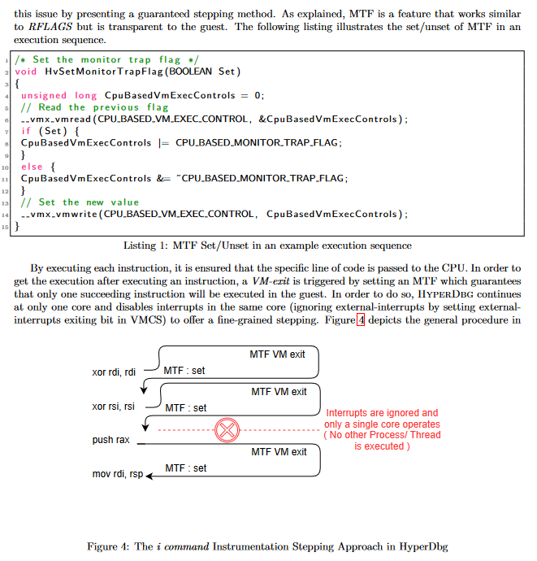
https://research.hyperdbg.org/

Slide 19
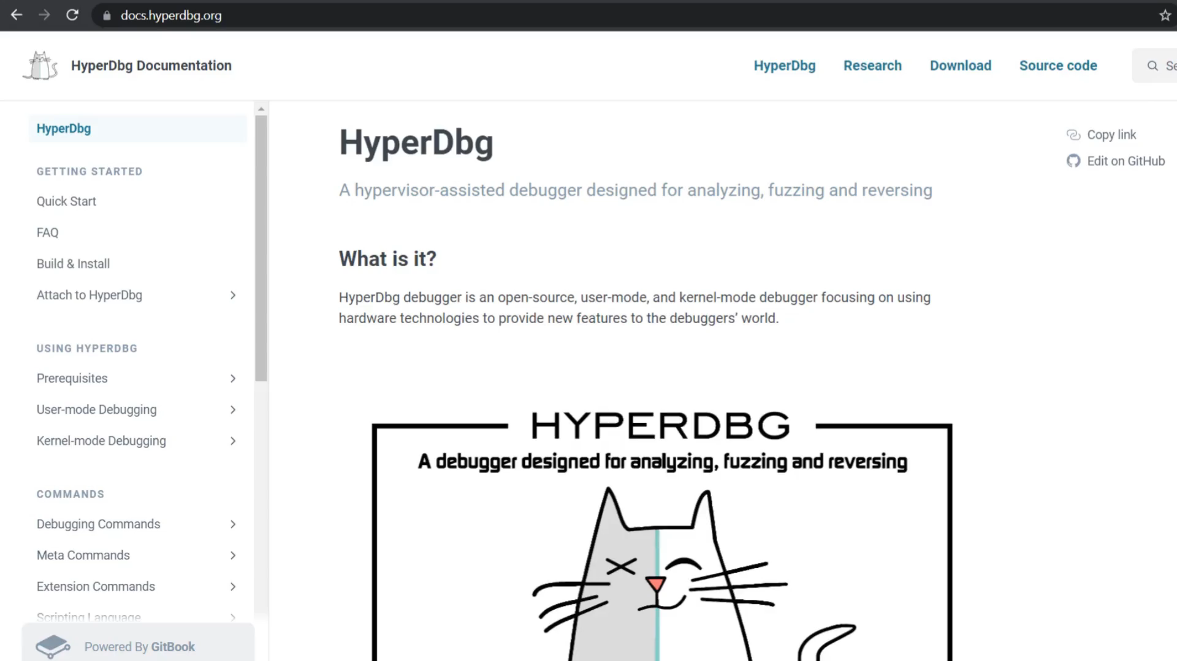

Slide 20

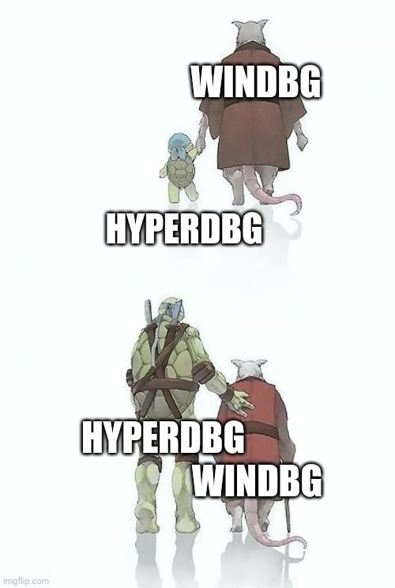
Thank you for your attention
Questions?

Slide 22
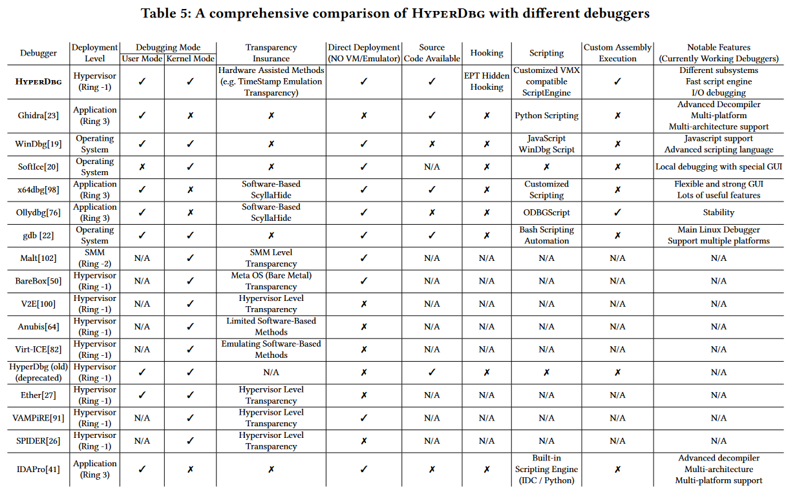

Slide 23
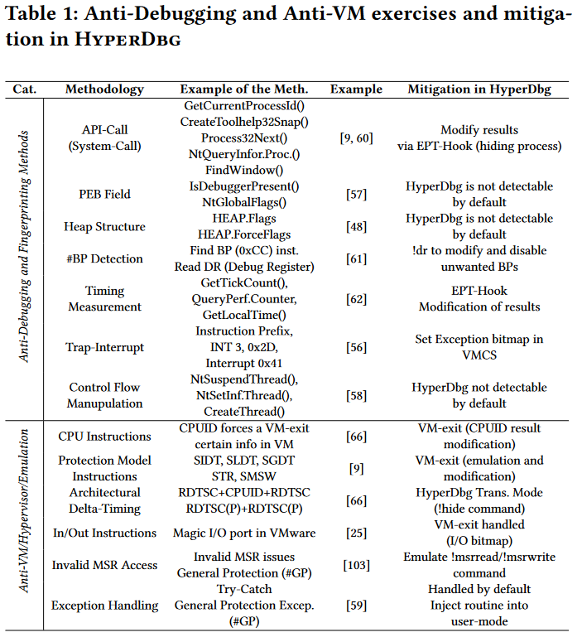

Slide 24
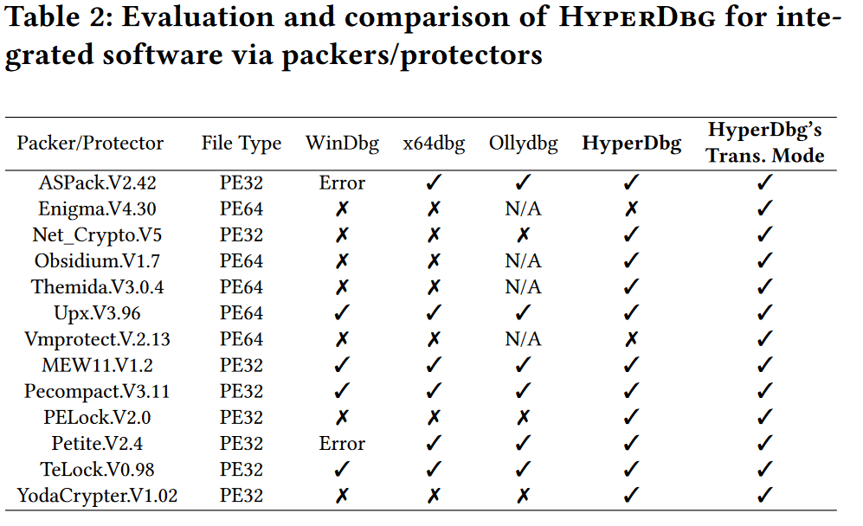

Slide 25
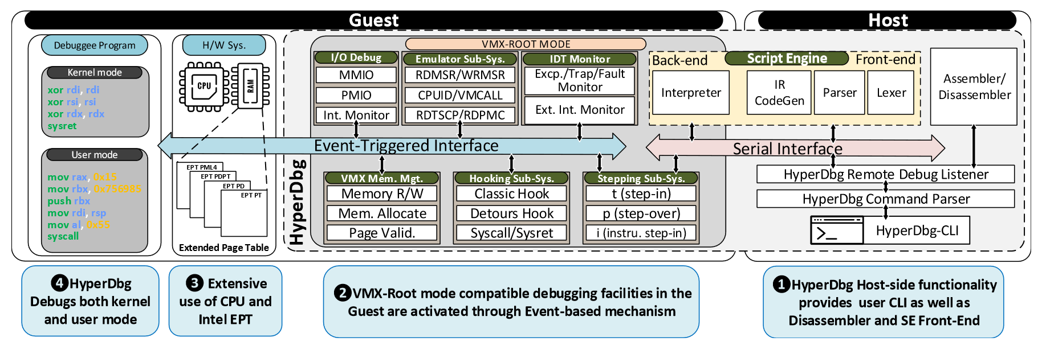

Slide 26
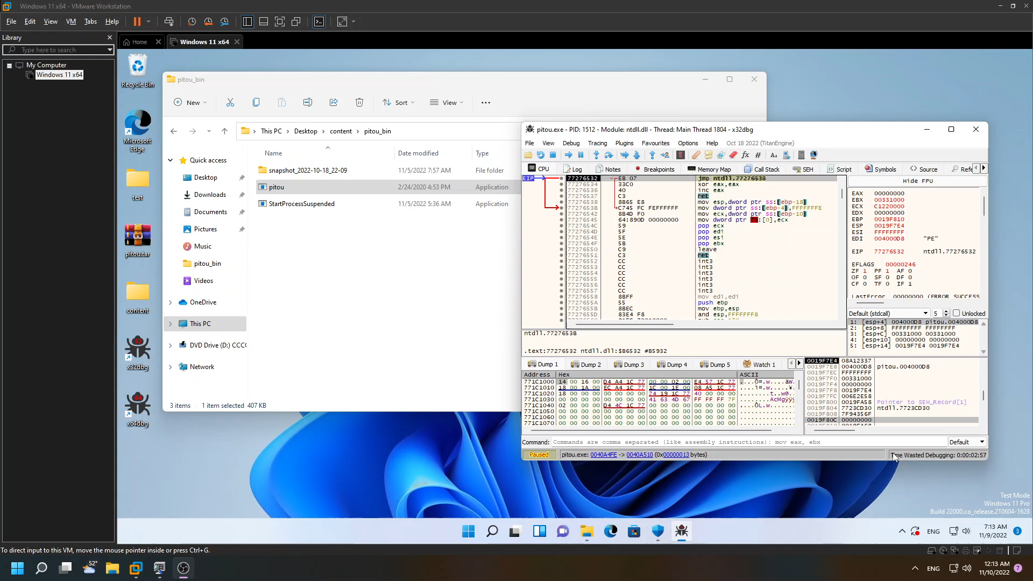
Pitou

Slide 27
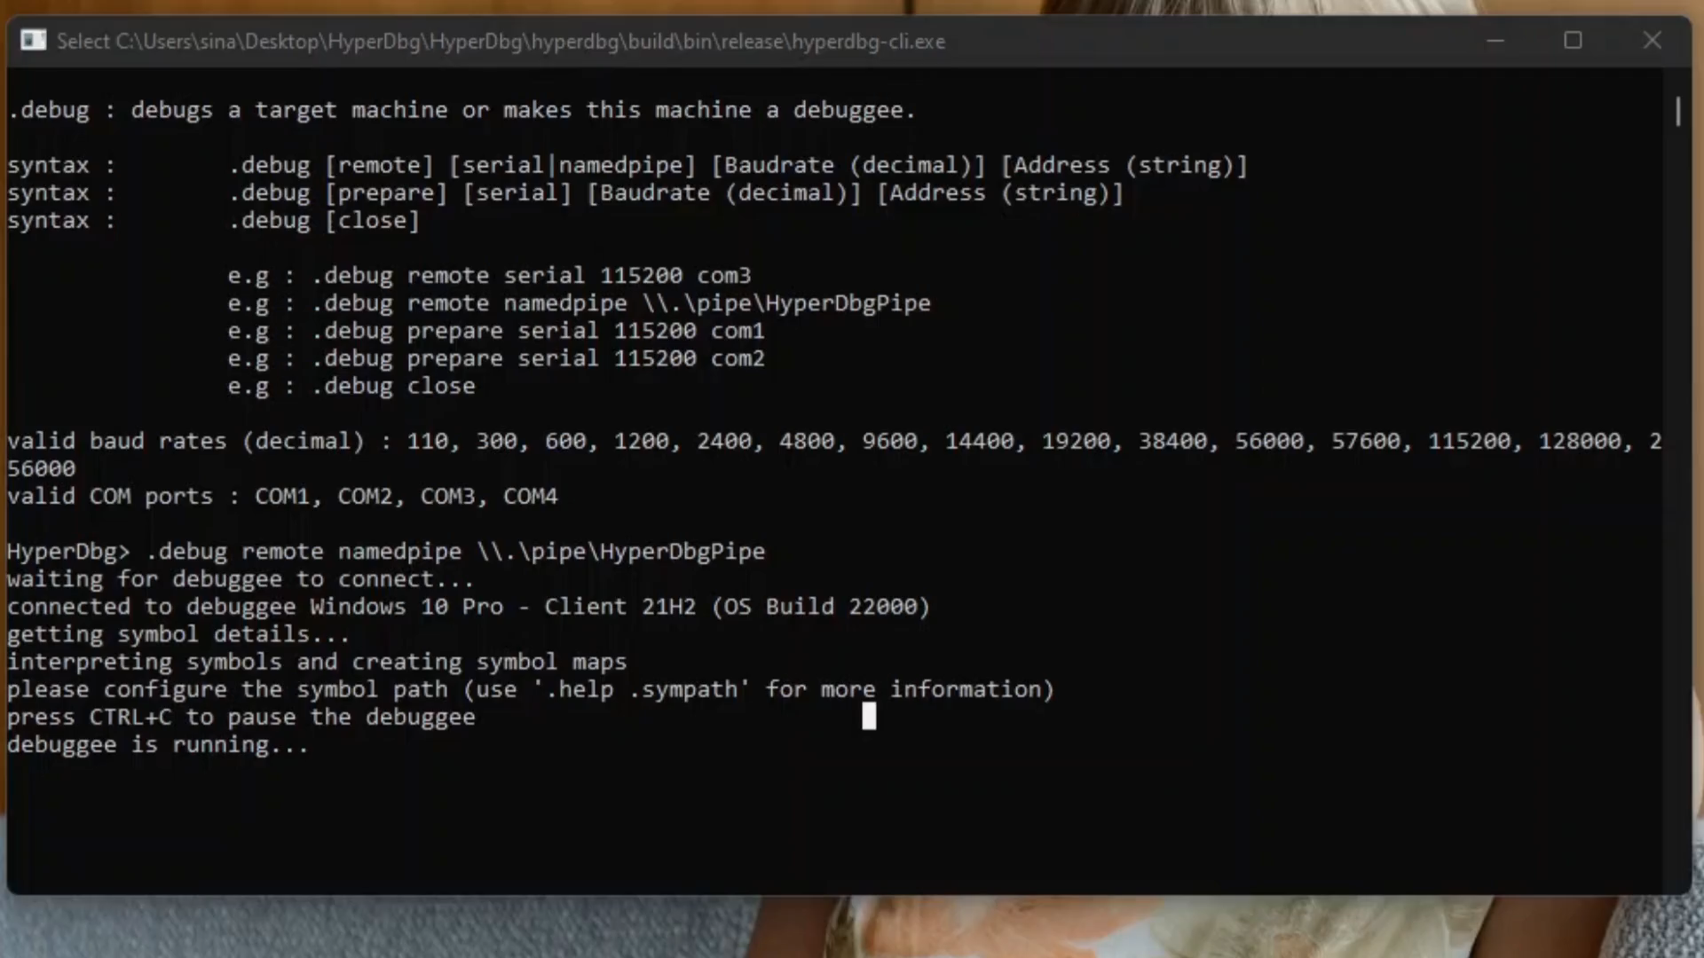
Debugger detected… Trying with HyperDbg

Slide 29




In honor of all the Iranians who are risking their lives in pursuit of liberty and human rights

Slide 30


